Slide 1

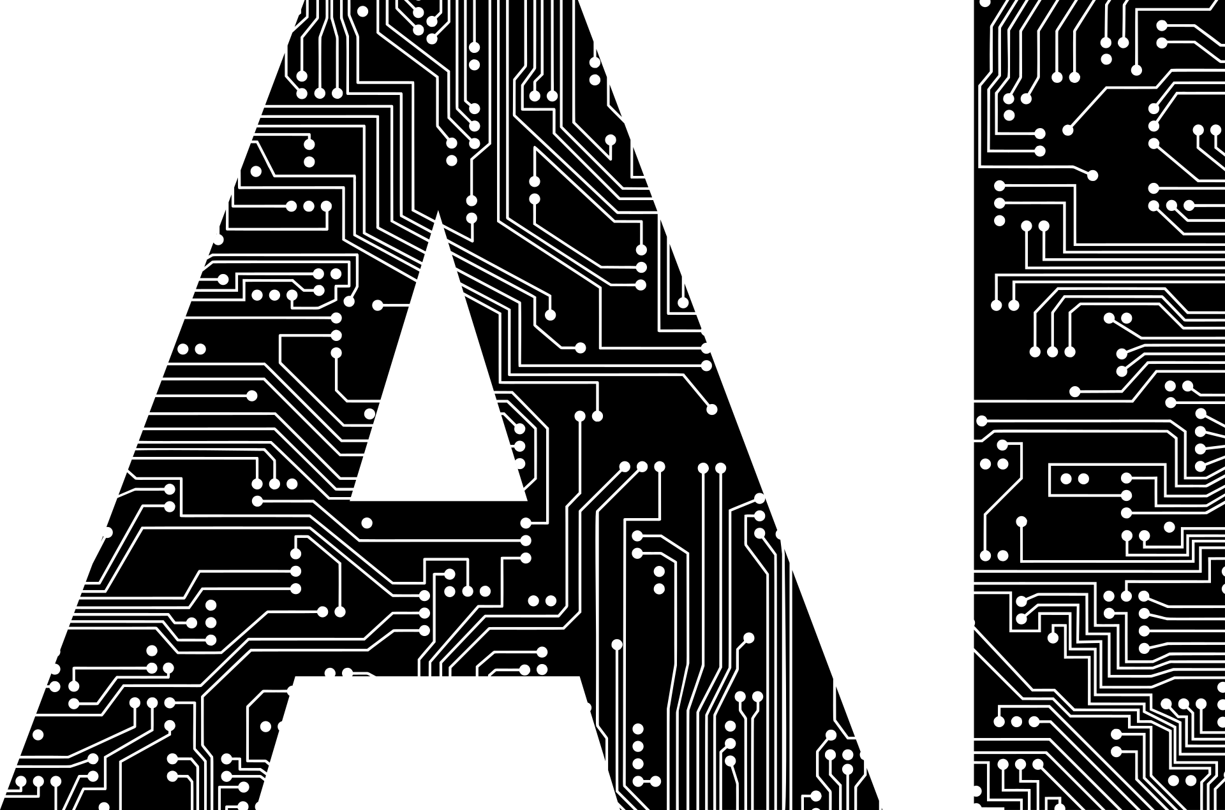
An Introduction to Artificial Intelligence
By Andrew Brown
Notes:
Hello everyone and thank you for tuning in.
This is the first video in my Introduction to Artificial Intelligence video series.
My name is Andrew Brown, and I’m a full-time student at Franklin University studying Cybersecurity and AI. I am also the President of Franklin’s Python Programming Club, and a Senior Officer in their Cybersecurity Club.
A decade ago, I fell down the AI rabbit hole. For me, it started as a fascination with path-finding algorithms for entities in video games. But over time, I’ve learned so much more, from creators like Andrej Karpathy, and Lex Fridman. Although I lack their expertise, I’d like to believe that my passion for the field makes it just a matter of time before I catch up.
In this series, I’m going to try and share some of that AI passion with you. If I’m successful, you’ll gain an appreciation for the architecture, hardware, and science powering text bots, image generators, and self-driving cars by the time we’ve finished.
This series is designed so that beginners who have only briefly heard of ChatGPT, or have briefly interacted with it, can follow along. If you want to understand what’s going on under the hood of this exciting technology, then you’re in the right place. By the end of this series, my hope is that you will feel confident discussing these core concepts with anyone, and that you’ll know what you’d like to explore next.
Let’s jump into how this series was built.

Slide 2
How this series was built
Voice-to-Text with WhisperTyping
Speak ideas out loud → instant transcripts
AI as an Editor and Co-Writer
GPT-4 + web search for structure, fact-checking, and phrasing
Collaborative Refinement
Bounce drafts with Claude & Gemini to dig into papers
Final Edits & Polish
Cut fluff, tighten flow, and package into bite-sized scripts manually
Notes:
First, and most importantly, I use WhisperTyping’s voice-to-text to capture my raw ideas. I speak my brainstorms out loud and get an instant transcript to work from, saving me many hours of typing.
Next, I feed those transcripts into an AI co-writer—mainly GPT-4 with its built-in web search tool—to organize notes, fact-check details, and suggest crisp phrasing.
Then, I bounce drafts back and forth with Claude and Gemini, diving into research papers and refining any rough edges. This step is optional and depends on the technicality of what you’re working on.
Finally, I stitch everything together into bite-sized scripts, cut out the fluff, and polish the flow manually; fitting content to your voice is still key despite the liberal use of AI.
That pipeline turned hours of talking and digging into research into these tightened episodes, so we spend less time digging and more time learning.

Slide 3


Want to go deeper?
Books:
Artificial Intelligence: A Modern Approach (4th ed.)
Mathematics: From the Birth of Numbers (Jan Gullberg)
Why Machines Learn (Anil Ananthaswamy)
Online Creators:
Andrej Karpathy’s “Intro to Large Language Models”
Lex Fridman’s various podcasts and interviews pertaining to AI
Notes:
If you’re hungry for more after this series, here are some of the resources I swear by.
Textbooks: The gold-standard is Artificial Intelligence: A Modern Approach.
For a general math deep-dive, Jan Gullberg’s Mathematics: From the Birth of Numbers is a must. I owe this book for my renewed interest in and appreciation of mathematics.
Next is Anil Ananthaswamy’s Why Machines Learn, which is excellent and offers a bridge between theory and practice.
Online Creators:
Andrej Karpathy’s video demos will show you how to code the concepts yourself, though he has fantastic introductory content as well.
Finally, Lex Fridman’s longform interviews give you a front-row seat to conversations with top AI researchers and industry experts.
If you have a favorite AI content creator or author, please drop a link to their social media in the comments.

Slide 4

Ready for Episode 1?
Up next → What AI is (and isn’t)
Notes:
That’s it for the intro. If you’d like, please take a moment to stretch or take a sip of water.
When you’re ready, we’ll dive into Episode 1: What AI is, and what it isn’t. I’ll see you there!

Slide 5
Episode 1:
What AI is (and isn’t)
Notes:
Welcome back to my Introduction to Artificial Intelligence series!
In this episode, I will be broadly defining what AI is and isn’t as well as covering a brief history of the field.

Slide 6
What AI Is
AI: Math and code that enable computers to perform tasks requiring human-like thinking—such as understanding language, recognizing images, making decisions, or learning from data.
Specialists:
Most AI today is narrow (specialists)—designed for a single task, highly accurate, but limited outside their domain.
Examples: facial recognition, language translation, game playing
Generalists:
Generalists handle many tasks flexibly, trading some precision for versatility.
Examples: conversational agents, multi-task assistants
Real-world generalists you may recognize:
Voice transcription (Whisper, Siri)
Content recommendations (Netflix, Hulu)
Chatbots (ChatGPT, Microsoft Copilot, Character.AI)
Notes:
Alright, let’s start by talking about what AI actually is.
At its heart, AI just means using math and code to solve problems that, until recently, only humans could handle.
Think of things like recognizing faces in photos, translating languages, or even playing games—these are all tasks where AI shines.
Most AI you’ll hear about today is what we call ‘narrow AI.’ That just means each system is really good at one specific job.
For example, you’ve got tools like Whisper or Siri that can turn your speech into text. Netflix has a recommendation engine that figures out what you might want to watch next, and chatbots like ChatGPT or Microsoft Copilot can hold natural conversations.
But these systems are specialists, not generalists—they don’t jump between wildly different skills the way people do.
You won’t see Siri playing chess, or Netflix chatting with you about the weather.
So, when you think of AI, don’t imagine a digital genius that can do everything.
Picture a collection of really smart, really fast assistants—each designed to tackle a specific problem.

Slide 7
What AI Isn’t
Not conscious: Today’s AI doesn’t think or feel—it recognizes patterns and predicts, but has no awareness.
Not AGI (Artificial General Intelligence): Each AI is a specialist, not a digital “brain” that understands everything.
Not always a robot: Most AI works behind the scenes, powering things like email filters, voice assistants, and search engines—no robot body required.
Not inherently good or evil: AI is a tool. Like most technology, its impact depends on how we design and use it, not on the AI itself.
Notes:
Now, let’s clear up what AI isn’t.
First—today’s AI isn’t conscious. It doesn’t have thoughts, feelings, or any self-awareness.
What it does is spot patterns and make predictions, but there’s no mind or understanding behind it.
We also don’t have AGI—Artificial General Intelligence—which is the kind of all-purpose, super-smart AI you see in movies.
Right now, each system is a specialist, built for one job, not a digital brain that understands everything.
Another common myth is that AI is always some kind of robot.
In reality, most AI works completely behind the scenes, quietly powering things like your email’s spam filter, your phone’s voice assistant, or even search results—no robot body required.
And finally, AI isn’t good or evil on its own. It’s just a tool. The way AI impacts the world depends on the people who design it, the data it learns from, and the goals we set for it.
So, when you hear about AI, don’t imagine a mysterious overlord or a sci-fi villain—think of it as a powerful tool that can be shaped for many purposes.

Slide 8
Early AI & Winters
1956: Dartmouth Workshop: Concept of “Thinking machines” is born—academics are wildly optimistic.
1960s
1966: ELIZA & Perceptrons: First chatbot wowed users; simple neural models emerge.
1970s
First AI Winter:
Hype crashes as common sense proves elusive—governments cut funding.
1980s
Expert Systems:
Rule-based programs (IF–THEN) shine in big industry—yet they’re brittle.
1990s
Second AI Winter:
Expert systems’ limits spark another funding freeze.
Notes:
Let’s wind the clock back to the dawn of AI. In 1956, a small team at Dartmouth declared, ‘We can build thinking machines!’—and just like that, the field was born.
By the mid-’60s, we had ELIZA, a primitive chatbot that fooled people into thinking they were talking to a therapist. Simple perceptron models emerged around this time, showing that neural networks weren’t just sci-fi.
But optimism met reality: replicating human common-sense reasoning was way harder than expected. By the 1970s, the first AI winter arrived—funding dried up and keyboards went quiet.
In the 1980s, expert systems revived hope—these big IF–THEN rule engines helped diagnose diseases and configure shipping routes. Yet, their rigidity couldn’t handle the messiness of the real world, and by the late ’80s into the ’90s, we slid into a second winter.
These early fits and starts taught us that intelligence isn’t just rules or simple nets—it’s a marathon, not a summer sprint.

Slide 9
Milestones & Modern AI
1997 Deep Blue vs. Kasparov: Chess champ toppled—AI in the headlines.
2011
Watson on Jeopardy!: Natural-language wizardry beats Ken Jennings.
2016
AlphaGo Defeats Lee Sedol: Go conquered by deep nets + reinforcement learning.
2012
ImageNet Win:
Deep neural nets revolutionize image recognition.
Late 2010s
Big Data:
Massive datasets + GPUs spark speech & vision breakthroughs.
2020s
LLM Era: GPT-3 to GPT-4, ChatGPT, Bard, Gemini—AI goes mainstream.
Notes:
After two winters, AI roared back with public-eye milestones. In 1997, IBM’s Deep Blue beat Garry Kasparov at chess—suddenly AI wasn’t just lab lore from the past: it was front-page news.
Fast-forward to 2011: IBM’s Watson stunned viewers on the game show Jeopardy!, parsing the tricky clues faster than champion Ken Jennings.
In 2012, a team at Hinton’s lab crushed the ImageNet challenge, unleashing modern speech and vision AI in phones, photo apps, and beyond.
Then in 2016, DeepMind’s AlphaGo—combining neural nets with reinforcement learning—vanquished South Korean Go master Lee Sedol in a game once thought immune to computers.
But the real revolution arrived in the late 2010s, when “deep learning” scaled up thanks to huge datasets—curtesy of a massive Internet—and Graphics Processing Unit clusters emerged to fuel the need for sheer compute power.
Today, we welcome the era of Large Language Models. From families of models such as ChatGPT, Copilot, Bard, Gemini, Claude, Mistral, and more, AI is in everyone’s hands now. It’s writing essays, generating images and videos, passing standardized exams, and even helping me create presentations like this.
It’s been a wild ride—from Dartmouth to Deep Blue to deep learning—and the next decade promises even more surprises.

Slide 10
Ready for Episode 2?
Machines Yearn to Learn: Supervised, Unsupervised & Reinforcement Paradigms
Notes:
And that concludes our whirlwind historical tour of AI.
Now that you know how we got here, in Episode 2 we’ll dive into the three core paradigms of machine learning. I’ll see you there!

Slide 11
Episode 2:
Machines Yearn to Learn: Supervised, Unsupervised & Reinforcement Paradigms
Notes:
Hello again, I’m Andrew Brown, and welcome to Episode 2 of An Introduction to Artificial Intelligence.
Before I dive in, I'd like to announce that I have added many hyperlinks throughout this presentation.
Most of these are my sources of information that I use to create this presentation, but some are just new and interesting.
Please feel free to explore these links by downloading the presentation and having a look for yourself.
Alright, today we’re shifting focus to how AI learning happens.
We’ll explore the three core machine-learning paradigms—supervised, unsupervised, and reinforcement learning—and then take a peek under the hood of neural networks.
By the end of this episode, you’ll understand how label-driven learning, pattern-finding without guidance, and reward-based strategies each power AI systems in the real world.
You’ll also get your first glimpse of the network structures that make it all possible.
Fair warning: compared to the first two episodes, this material gets a bit denser.
Ready to see how machines learn? Let’s dive in!

Slide 12

Machine Learning & Two Core Styles
Machine Learning (ML)
A subset of AI where algorithms learn patterns from data instead of being explicitly programmed.
The system improves at a task by example—no hard-coded flowcharts needed.
Supervised Learning
Learning from labeled examples (“learning with a teacher”).
We feed input–output pairs (e.g. X-ray + “tumor”/“no tumor”) so it can predict new cases.
Widely used for classification (spam vs. not-spam) and regression (predicting house prices).
Unsupervised Learning
Learning from unlabeled data—algorithm finds hidden patterns or groupings on its own.
No explicit “right answer” given.
Common uses: clustering customers by behavior, dimensionality reduction, anomaly detection.
Notes:
Now that we’ve seen how AI evolved, let’s zoom in on the engine under the hood: machine learning.
At its core, machine learning means teaching computers by example, instead of writing every rule by hand.
Instead of me coding a flowchart to spot cats, I feed an algorithm thousands of cat photos and let it learn what “cat-ness” looks like on its own.
First up is Supervised Learning—think of a student drilling with flashcards. We give the model inputs paired with the correct answers.
For example, you show a neural network thousands of X-rays labeled ‘tumor’ or ‘no tumor.’
By seeing enough examples, the model tunes itself to predict labels on brand-new scans.
Whenever you hear about “accuracy” or “predictions” on labeled data, that’s supervised learning in action.
Next is Unsupervised Learning, where the computer is an explorer without a map.
We hand it raw, unlabeled data, and it seeks out hidden structure all on its own:
grouping customers by purchasing habits, detecting anomalies in server logs, or discovering topics in text.
There’s no right or wrong answer—it simply uncovers whatever patterns lurk in the data.
These two flavors—supervised with teacher-provided answers, and unsupervised with pure pattern discovery—power a huge swath of AI today.

Slide 13
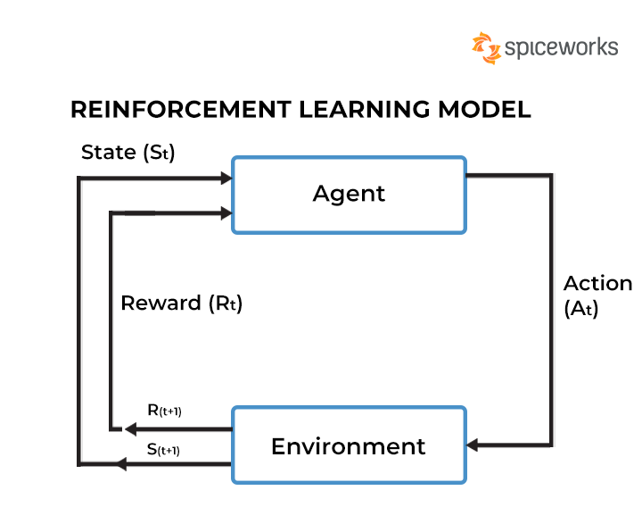
Reinforcement Learning & Recap
Reinforcement Learning (RL)
Learning by trial and error through feedback (rewards or penalties).
An agent interacts with an environment, earns points for good actions, and over time discovers winning strategies.
Real-world uses: game playing (AlphaGo), robotics, control systems, data-center optimization.
Quick Recap of the Three Styles
Supervised: Flashcards with answers.
Unsupervised: Explorer finding patterns.
Reinforcement: Carrot-and-stick trial and error.
Why It Matters
Recognize which paradigm powers any AI system you encounter—this is key to ‘speaking’ the AI language!
Notes:
Finally, we have Reinforcement Learning, which is all about learning by doing.
Think of training your dog with treats: an RL agent tries actions in an environment, earns rewards or faces penalties, and over many trials discovers the best strategy—just like AlphaGo mastering Go by playing itself millions of times.
In real life, RL helps robots learn to walk, game AI learn to win, and even data centers learn to use less energy.
To recap our three core learning styles:
Supervised: like flashcards with correct answers.
Unsupervised: like assembling a puzzle with no picture on the box.
Reinforcement: like carrot-and-stick trial and error with simulated rewards.
With these three paradigms in your toolkit, you’ll instantly recognize how any AI system you read about is learning its task.
Next up: let’s dive into the inner workings of neural networks!

Slide 14
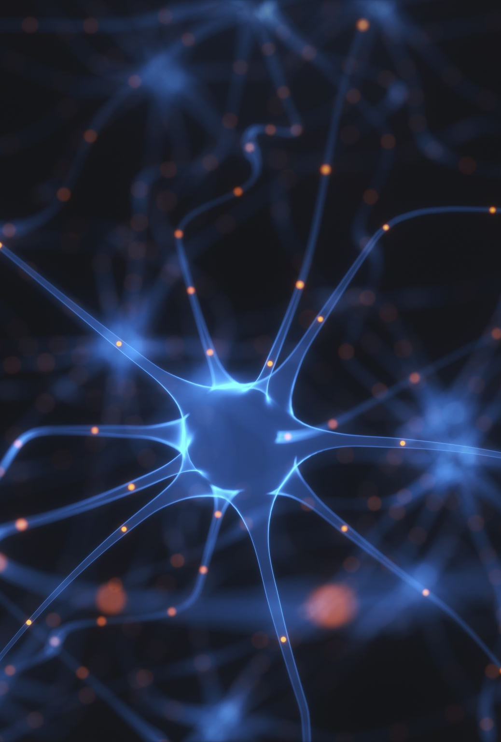
Anatomy of a Neuron & Activation Functions
Neuron Basics
Inputs × weights + bias → sum → activation
ReLU (Rectified Linear Unit):
f(x) = max(0, x)
Fast, avoids vanishing gradients, but can “die” if stuck at zero
Sigmoid
σ(x) = 1 / (1 + e^(–x))
Smooth S-curve like a normal CDF → outputs 0–1 (great for probabilities)
Drawbacks: vanishing gradients, positivity bias
Notes:
Let’s zoom into a single neuron, the basic computation unit in a neural network.
A neuron takes several inputs—numbers that could represent pixel intensities or any observable features.
It multiplies each input by a weight, which you can think of as how much that input matters.
Then it adds them all together with a bias term.
A bias term is a constant added to the weighted sum before the activation function.
It lets the neuron shift its activation threshold, helping the model fit data better—even when inputs are zero.
That total then passes through an activation function, which decides the neuron’s output—basically asking, “Should I fire? And if so, by how much?”
One popular activation is the Rectified Linear Unit, or ReLU.
Mathematically, it’s written as “f of x equals the maximum of zero and x.”
If the sum is negative, ReLU outputs zero; if positive, it outputs the input unchanged.
ReLU is lightning-fast in hardware and helps prevent the vanishing gradient problem.
Now, a gradient is basically the slope or rate of change of the loss function with respect to the neuron’s weights.
It tells the network how to adjust those weights to improve performance.
If the gradient gets too small, learning slows or stops.
ReLU helps keep gradients healthy by avoiding tiny values, but neurons can still “die” if they constantly output zero, causing zero gradients.
Another classic activation function is the sigmoid, denoted as “Sigma of x equals one divided by one plus e to the negative x.”
It produces a smooth, S-shaped curve, squashing any real number between zero and one.
This makes sigmoid great for output layers when you need a probability estimate.
However, for very large or small inputs, its gradient becomes vanishingly small, slowing learning in deep networks.
Also, because sigmoid outputs are always positive, it can introduce a positivity bias—a tendency to focus more on positive information during weight updates.
Understanding these two functions—ReLU for fast, unbounded activation, and sigmoid for smooth probability outputs—gives you insight into how each neuron shapes the flow of information through the network.

Slide 15
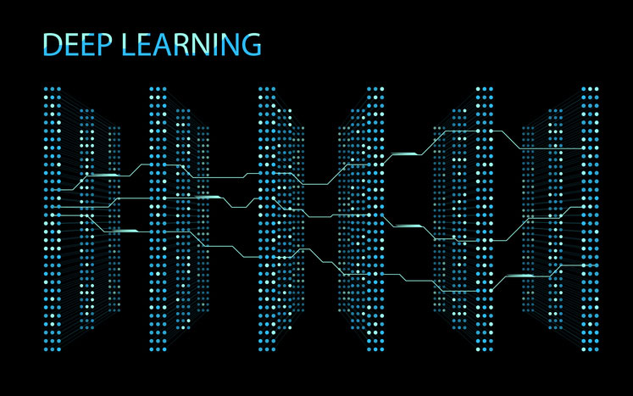
Network Architecture & Learning
Layers of Neurons
Input layer → hidden layers → output layer
Early layers learn simple features; deeper layers build abstractions
Deep Learning
“Deep” = many hidden layers → capture complex patterns
Learning by Weight Updates
Start with random weights → measure error on each example → tweak weights to reduce error
Repeat over millions of examples (e.g., image classifier or self-play in AlphaGo)
Notes:
Now, imagine stitching those neurons into layers to form a full neural network.
The input layer takes raw data—like pixel values from an image or numerical features from text.
That data flows through one or more hidden layers, where each neuron responds to patterns from the previous layer:
Early hidden layers might detect edges or basic textures, while deeper hidden layers recognize object parts or semantic features.
Finally, the output layer produces the network’s result, such as probabilities for each possible label—like ‘cat’ versus ‘dog.’
When we say deep learning, we simply mean a network with many hidden layers.
Depth allows the model to learn rich, hierarchical feature representations—from low-level details to high-level abstractions—unlocking breakthroughs in image recognition, speech processing, and natural language understanding.
But how does the network actually learn?
It starts with all weights set randomly, so initial predictions are basically noise.
Then, for each training example, the network makes a prediction and we compute an error—how far that prediction is from the true label.
Using that error, we adjust each weight slightly in the direction that reduces the error, repeating this process millions of times.
Picture each weight as a tiny knob on a massive control panel.
Every time the network sees a new example, it measures its mistake and nudges those knobs a little toward better performance.
Over countless iterations—whether classifying images or playing games like AlphaGo—the network converges on a set of weights that make it highly accurate.
This interplay of layered structures and iterative weight updates is at the heart of neural network training—powering everything from your voice assistant to state-of-the-art language models.

Slide 16
Ready for Episode 3?
From Weights to Wisdom: Understanding Neural Network Learning
Notes:
With that, we’ve reached the end of Episode 2.
I know we covered a lot, and some of the math might have been a bit tough to chew through.
If you have any questions, please don’t hesitate to reach out—I’m happy to help clarify anything.
In the next episode, we’ll dive deeper into how neural networks learn, focusing more on weights, layers, parameters, and activations.
I’ll see you next time!

Slide 17
Episode 3:
From Weights to Wisdom: Understanding Neural Network Learning
Notes:
Hello and welcome to Episode 3:
I’m Andrew Brown, and today we’re peeling back the curtain on the nuts and bolts of deep learning.
We’ll start by exploring weights—the little numbers that encode a model’s memory—and see how layers stack up to build richer features.
Next, we’ll talk about parameters and how architectures like Mixture-of-Experts scale to billions of them.
Then, we’ll dive into activations—the non-linear magic that makes networks expressive.
Finally, we’ll demystify backpropagation and gradient descent, the calculus-powered duo that tunes every weight in the network.
Let’s jump in!

Slide 18
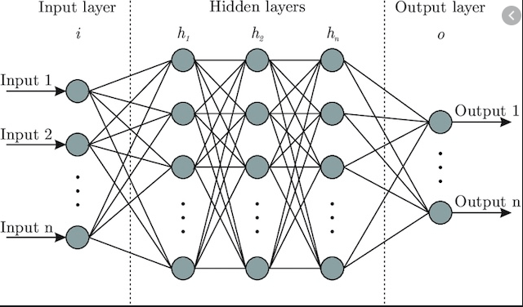
Layers
Input Layer
Ingests raw data (pixels, features)
Hidden Layers: 1–N stages of abstraction
Early: simple patterns (edges, colors)
Mid: parts/phrases (shapes, word n-grams)
Deep: high-level concepts (objects, semantics)
Output Layer
Final prediction or score
Notes:
Next up: layers.
Think of a neural network as a stack of processing stages.
The input layer takes raw data—pixel values for images or numeric features for text.
That feeds into one or more hidden layers, each working at a higher level of abstraction.
Early hidden layers might detect edges or color contrasts; middle layers assemble those into shapes or word combinations; deep layers can recognize objects or sentence meaning.
Finally, the output layer produces the network’s decision—probabilities for each class or a predicted value.
When someone says a network has 12 layers, they’re usually counting all hidden layers plus the output.
The balance of depth (number of layers) and width (neurons per layer) is a key architectural choice.
Deeper networks can learn richer hierarchies but require more data and compute power.

Slide 19
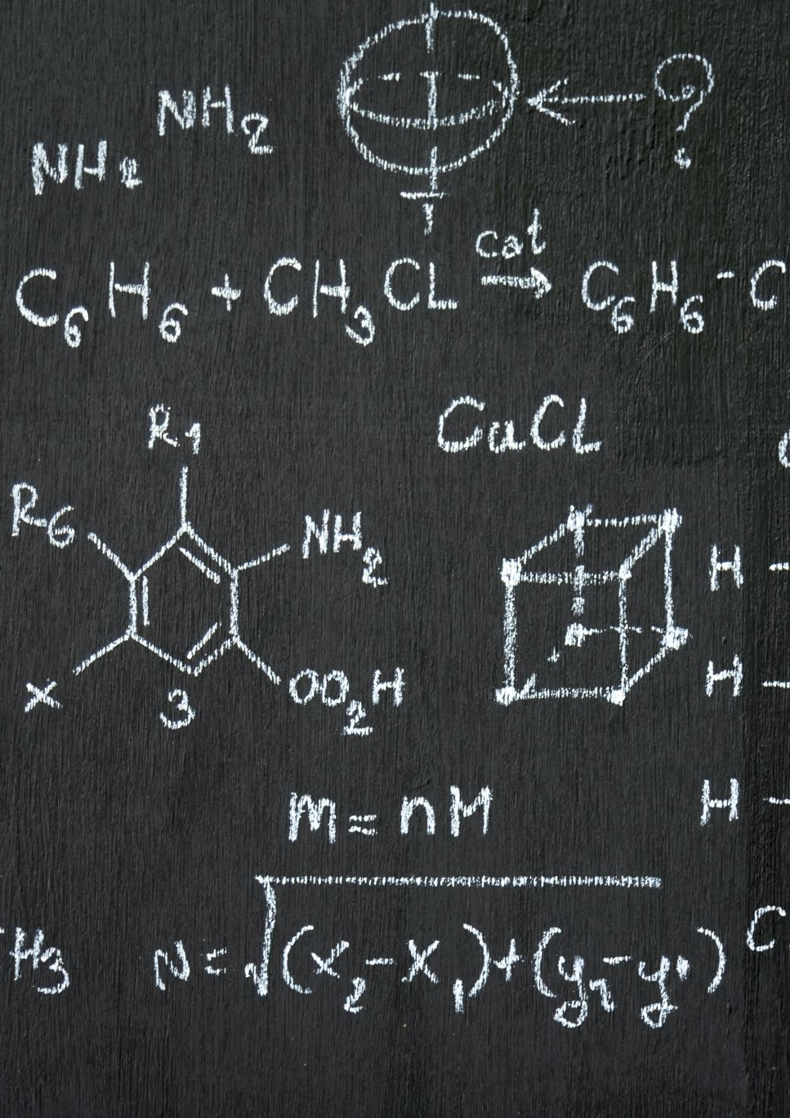
Parameters
Parameter = any learnable weight or bias in a neural network.
Total parameters ≈ model capacity.
Example: GPT-3 has 175 B parameters and was trained on ≈ 499 B tokens.
Token = the model’s smallest text chunk (roughly 4 characters ≈ ¾ of a word in English). Mixture of Experts (MoE)
MoE architectures can scale beyond one trillion parameters while activating only a small sub-network for each token.
Example: GLaM — 1.2 T total, but ≈ 97 B (∼ 8 %) active per token via Top-2 gating. Google Research
Why it matters: sparse activation lets models grow capacity without proportional increases in compute or memory at inference time.
Notes:
Moving along, we’ve got parameters.
Imagine every parameter as a little knob or dial inside the model—the weight and the bias are just two types of those knobs.
When I say a model has ten million parameters, I really mean it has ten million of those knobs it learned to adjust so it can recognize patterns in data.
Now, take GPT-3 as an example. It has about one hundred and seventy-five billion of those knobs, which is why it can capture so much information, and it learned them by reading roughly half a trillion words of text.
Next, we’ll talk about how engineers make these huge models more efficient without losing power.
They use something called a mixture of experts. Picture a big group of specialists—say, sixty-four different teams—each one tuned to handle different kinds of tasks.
Instead of sending every piece of text to all sixty-four teams (which would be slow and costly), the model uses a small “gatekeeper” network to pick just two teams that are best suited for that particular piece of text.
Google’s GLaM model is a good illustration: behind the scenes it actually contains about 1.2 trillion knobs, but because it only activates two of those teams at a time, it only turns on around ninety-seven billion knobs for each input.
That way, you get almost all the power of a gigantic model without paying the full cost in computing every single time.

Slide 20
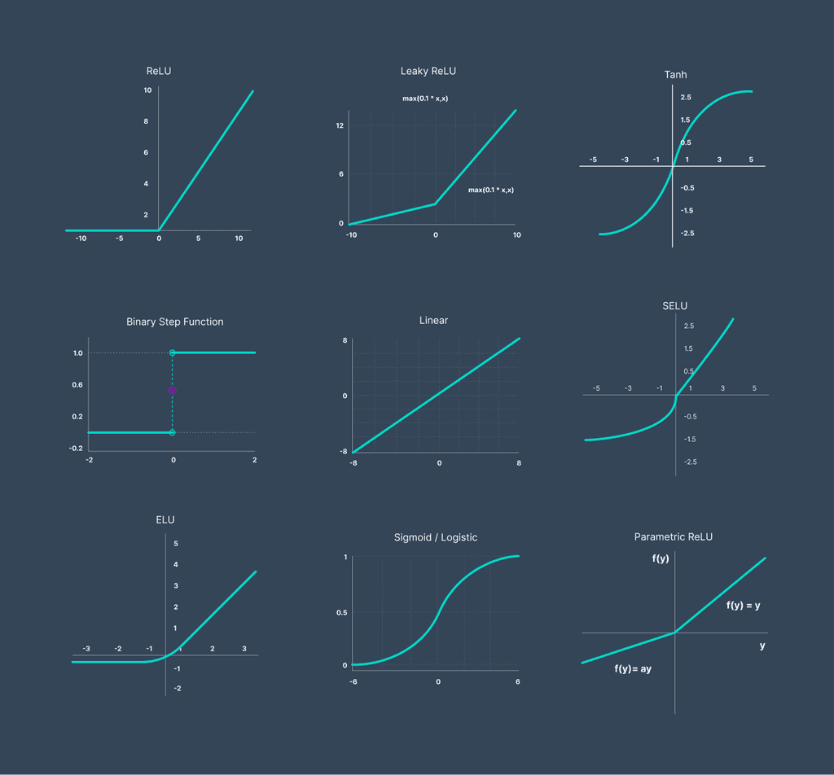
Activations
Activation Value: the neuron’s output signal
Common activations
ReLU: f(x)=max(0,x) → fast, avoids vanishing gradients
Sigmoid: σ(x)=1/(1+e^(–x)) → smooth 0–1 output
Tanh: maps to –1…1Role: introduce non-linearity; model complex boundaries
Notes:
When data flows through a neuron, it produces an activation value—the feature it has detected.
To compute that, we pass the weighted sum plus bias through an activation function, injecting non-linearity so the network can model curves, not just straight lines.
I touched on a few activation functions last episode, but here’s a quick recap because they’re so important:
ReLU, or Rectified Linear Unit, zeroes out negative inputs and passes positive ones unchanged.
It’s computationally efficient and helps avoid the vanishing gradient problem, but neurons can “die” if they never fire.
Sigmoid, as mentioned before, squashes inputs into a smooth S-shaped curve between zero and one—great for probabilities but prone to saturation.
Tanh is similar, mapping inputs to values between minus one and one, producing zero-centered outputs.
Without these nonlinear activations, stacking layers would collapse into a single linear operation.
It’s the non-linearity at each neuron that gives deep networks their expressive power.

Slide 21
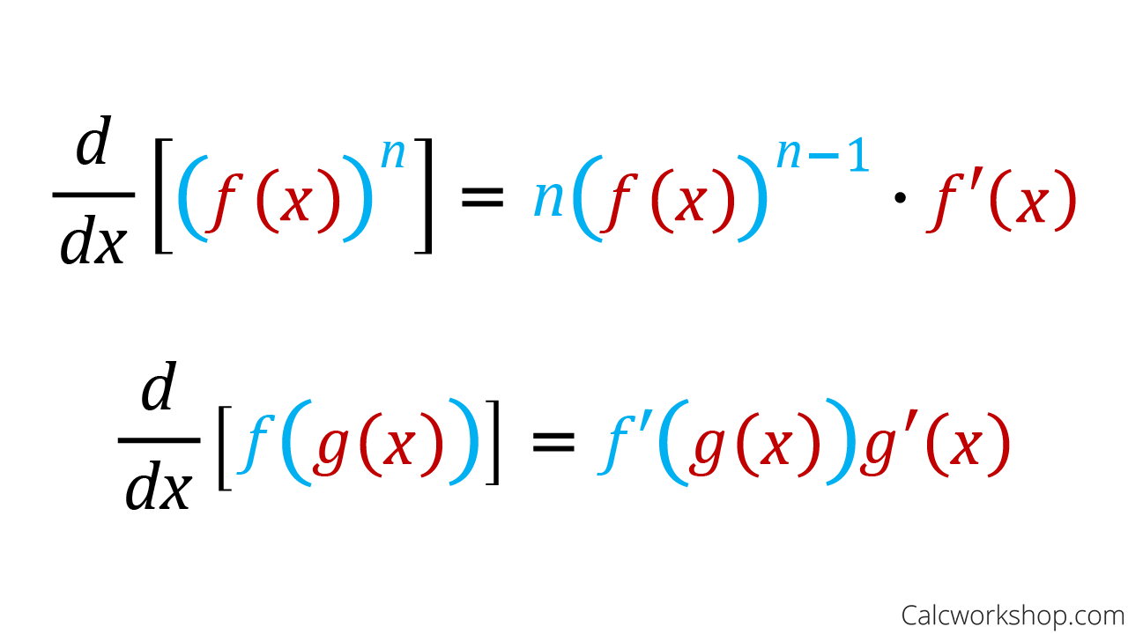
Backpropagation & Gradient Descent
Chain Rule (Calculus)
Derivative of composed functions → sensitivity of error to each weight
Backpropagation
Propagate error backward layer by layer
Assign each weight its “blame” (gradient)
Gradient Descent
Update rule: w ← w – η · (dLoss/dw)
η = learning rate → step size
Notes:
Alright, brace yourself—this slide gets into the nuts and bolts of how a neural network actually tunes itself, and yes, it leans on somewhat advanced calculus.
If your hair stood on end as you detected a steep learning curve ahead, don’t worry: you’re in good company! In this series, we’re doing a flyby of these ideas—think orbital pass by Mars, not landing to scoop soil.
In a future deep dive, I’ll unpack every derivative, but here we’ll focus on the key steps.
Neural networks are just layers of functions composed together.
The chain rule lets us ask, “If I tweak this one weight by a tiny amount, how does it shift the final error?”
That sensitivity—the derivative of the loss with respect to each weight—is what we call a gradient.
Backpropagation: Once the network makes a prediction and we measure its error, we propagate that error signal backward through each layer.
At every connection, backprop computes exactly how much ‘blame’ each weight bears for the mistake—that gradient tells us which dials to turn.
Gradient Descent: With all the gradients in hand, we update each weight:
new_weight = old_weight minus eta times gradient, where eta (η) is the learning rate—a small constant controlling our step size.
Think of it like adjusting the volume knob on your car stereo—volume might go from 1 to 50, and each increment or decrement is one click.
By repeatedly nudging each weight opposite to its gradient over millions of examples, the network gradually converges to a set of weights that minimize error.
And that’s the high-level picture: chain rule to compute sensitivities, backpropagation to assign blame, and gradient descent to correct it.
We’re not diving into every proof here—that’s a whole future series at least—but now you have the mental map of how neural nets learn from their mistakes.

Slide 22
Ready for Episode 4?
From Weights to Wisdom: Understanding Neural Network Learning
Notes:
And that wraps up our deep dive into the nuts and bolts of neural networks!
We’ve seen how weights tune every connection, layers stack up feature abstractions, and parameters measure a model’s capacity.
We looked at activations—from ReLU to sigmoid—that inject the non-linearity making deep nets so powerful.
And we walked through backpropagation and gradient descent, the calculus-driven engine that nudges each weight toward lower error.
With these fundamentals in your toolkit, you now speak the core language of deep learning.
In the next episode, we’ll build on this foundation and explore deep learning a little more.
We’ll also dive into large language models and training concepts, including data sets, fine-tuning, and self-supervision.
See you there!

Slide 23
Episode 4:
From Weights to Wisdom: Understanding Neural Network Learning
Notes:
Hello everyone, and welcome to the final episode of Act 1. Now that we’ve got the nuts and bolts of neural nets under our belt, it’s time to zoom out and see how it all comes together in the real world.
Over the next few slides, we’ll cover three big areas:
First, how deep learning became the bedrock of today’s AI, powering Large Language Models like GPT-4 and Claude.
Second, the training toolkit: the data that fuels AI, the magic of self-supervised learning, and the art of fine-tuning and quantization to build and deploy models intelligently.
Finally, we’ll close with a small recap and key takeaways, including what content you can expect to see in Act 2.

Slide 24
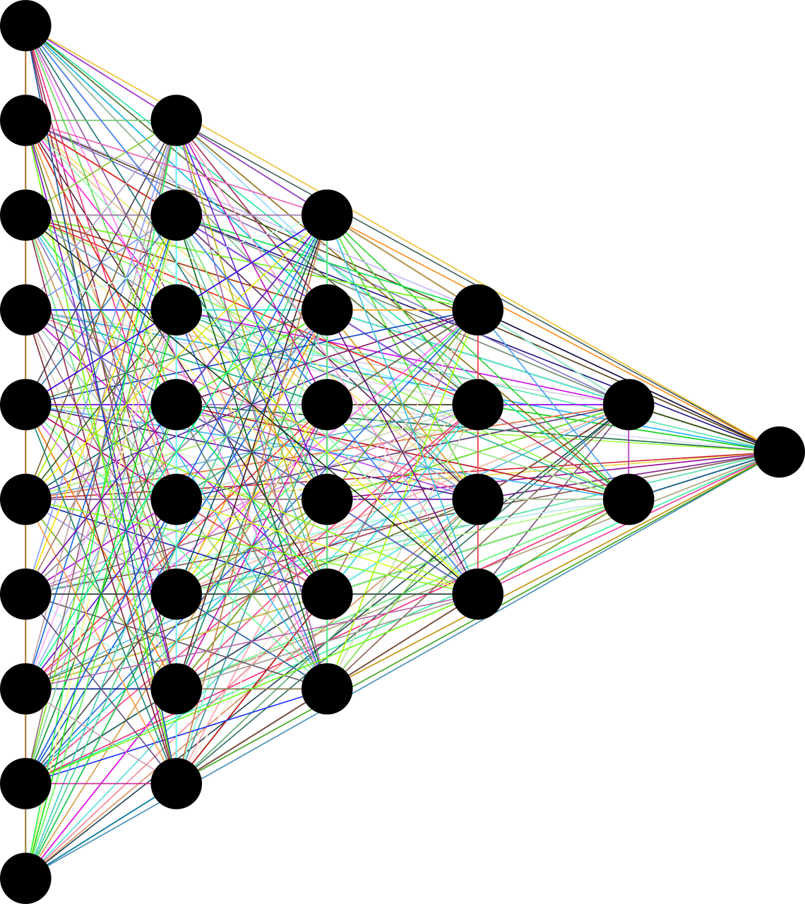
Deep Learning Basics
Deep Learning
Neural networks with many (“deep”) layers learn raw data hierarchies automatically—no hand-crafted features required.
Shallow → Deep
Early ML needed manual feature engineering; deep nets (10s–100s of layers) unlock complex function approximation.
Data & Compute Trade-off
Deeper networks demand massive datasets and GPU/TPU clusters, but deliver dramatic performance gains (ImageNet error rates post-2012).
Hierarchical Features
Layers build up:
edges → shapes → objects (vision)
words → phrases → meaning (language).
Notes:
We’ve talked about neural networks, and now it’s time to go deeper—literally!
Deep learning means using networks with many layers—sometimes dozens, even hundreds.
Each layer automatically learns features from raw inputs: in vision, early layers spot edges and colors, deeper layers assemble those into shapes and textures, and the deepest layers recognize entire objects.
Likewise, in language, lower layers pick up characters and word patterns, while higher layers grasp phrases and semantics.
This contrasts with the shallow approaches of old, where practitioners hand-crafted features—like edge detectors or part-of-speech tags—and fed those into simpler models.
Deep nets bypass that manual work by learning hierarchical representations on their own—but the catch is they demand massive datasets and huge compute power, like large clusters of GPUs.
Those investments paid off spectacularly: after the 2012 ImageNet breakthrough, error rates plummeted as networks grew deeper.
That shift from shallow to deep is what unlocked modern breakthroughs in computer vision, speech recognition, and natural language processing.

Slide 25
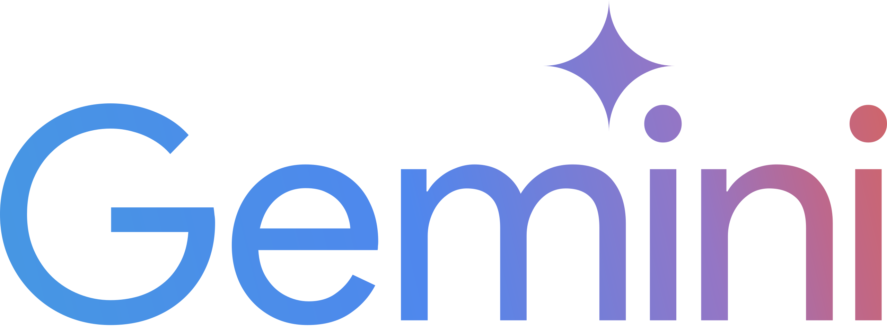

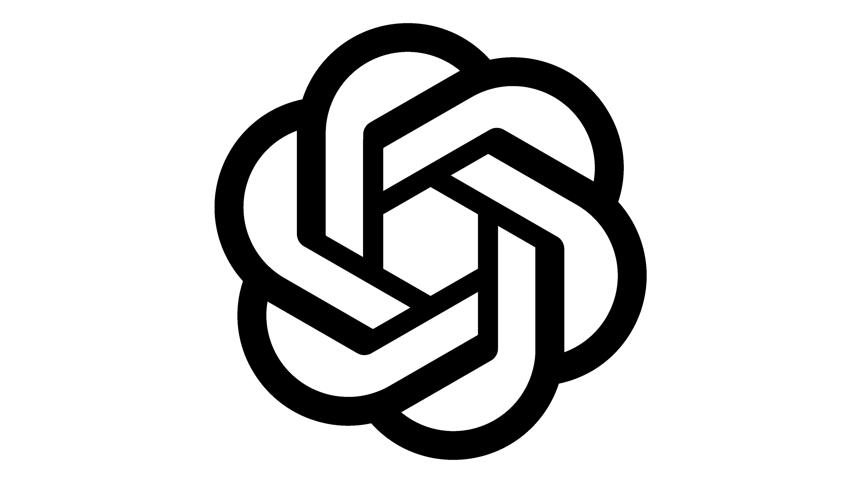

Large Language Models
What is an LLM? A Transformer-based deep net with billions+ of parameters, trained via self-supervised next-word (or masked-word) prediction.
Training Scale GPT-3 had ~175 B parameters on ≈ 500 B tokens; larger models keep improving as they grow.
Capabilities Fluent text generation, translation, Q&A, code synthesis—via statistical language modeling.
Emergent Behaviors Untrained skills (basic math, reasoning) appear once models cross scale thresholds.
Some studies observe apparent jumps in abilities (e.g., reasoning) as models pass the 100 B-parameter scale, though newer analyses suggest the effect may be a measurement artifact.
Notes:
One of the crown jewels of deep learning today are Large Language Models, or LLMs.
Think of an LLM as a Transformer-based neural network with billions of parameters, pre-trained on internet-scale text via self-supervised learning—often by predicting the next word or filling in a masked word.
So, what exactly is a Transformer?
Transformers are a type of architecture that powers many of today’s large language models.
At their core, transformers help the model understand the relationships between words in a sentence—or even across whole paragraphs—by paying attention to context.
Imagine reading a sentence and remembering which words relate to each other, even if they’re far apart.
Transformers do exactly that, using something called self-attention to weigh the importance of every word relative to the others.
This ability to focus on different parts of the input all at once lets transformers capture meaning much better than older models that read word by word.
They process text in parallel, which makes training faster and more efficient.
Because of this, transformers have revolutionized natural language processing, enabling applications like chatbots, translation, and summarization to work with impressive accuracy and nuance.
For example, GPT-3 packed around 175 billion parameters and ingested roughly 500 billion tokens of text during training.
As you scale both data and model size, performance improves in remarkably smooth scaling laws, and new, emergent abilities—like arithmetic, code generation, or rudimentary reasoning—appear once you cross certain size thresholds.
Today’s LLMs—GPT-4, Claude, PaLM, LLaMA—all share this recipe: Transformer architecture plus massive data plus massive parameters.
The result is a model that can generate human-like text, translate languages, answer questions, write code, and more, simply by predicting the most likely next words.
They don’t “understand” language as we do, but statistically, they’ve seen so many patterns that they can mimic understanding impressively well.
These models have made natural language AI a household topic and set the stage for the rest of our exploration.

Slide 26
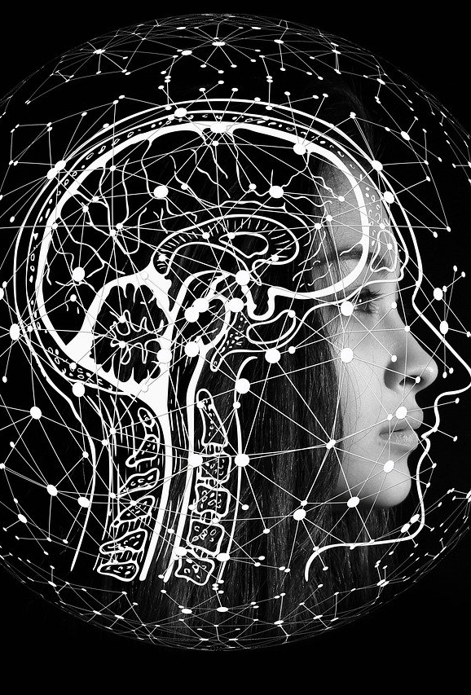
Data, Fine-Tuning & Self-Supervision
Datasets, the Fuel for AI
ML is data-hungry—quality & quantity matter! Free modern datasets: Kaggle, Open ML, Sigma AI
Fine-Tuning • Pre-train on broad data, then train again on a smaller, task-specific set • Speeds up development & boosts domain accuracy • Example: BERT pre-trained on general text, fine-tuned for movie-review sentiment
Self-Supervised Learning • The data labels itself via pretext tasks (masked words, image colorization) • Unlocks mountains of unlabeled data—no human annotation needed • Drives both language (next-token prediction) and vision (jigsaw, color fill) breakthroughs
Notes:
Let’s talk about data, fine-tuning, and self-supervision a bit more.
Deep learning success stories all rest on these three training pillars.
First, datasets are the fuel that powers model training. The mantra “garbage in, garbage out” holds true—if your data is noisy, biased, or too small, your model will be too.
We split data into training, validation, and test sets to measure real performance.
Landmark datasets like ImageNet, with 1.2 million labeled images, and internet-scale text crawls like Common Crawl and Wikipedia enabled breakthroughs by providing the raw material.
Second, fine-tuning has become the dominant workflow.
Instead of training from scratch for every task, we pre-train a general model on broad data and then “specialize” it on a smaller, task-specific dataset.
It’s like teaching a student general science and math, then sending them to medical school for specialization.
BERT, for instance, was pre-trained on unlabeled text and then fine-tuned on sentiment-labeled movie reviews to achieve state-of-the-art accuracy.
Fine-tuning drastically reduces data needs and speeds development.
Third, self-supervised learning ingeniously turns raw data into its own training signal—no human labels needed.
In language, we mask words and ask the model to predict them; in vision, we might mask a patch of an image or scramble it into jigsaw pieces before asking it to reassemble.
Because the data already contains the “answers,” we can train on mountains of unlabeled examples, driving powerful representations without costly annotation efforts.
Together, these three strategies form the backbone of modern AI development—knowing them is key to building and adapting real-world systems.

Slide 27
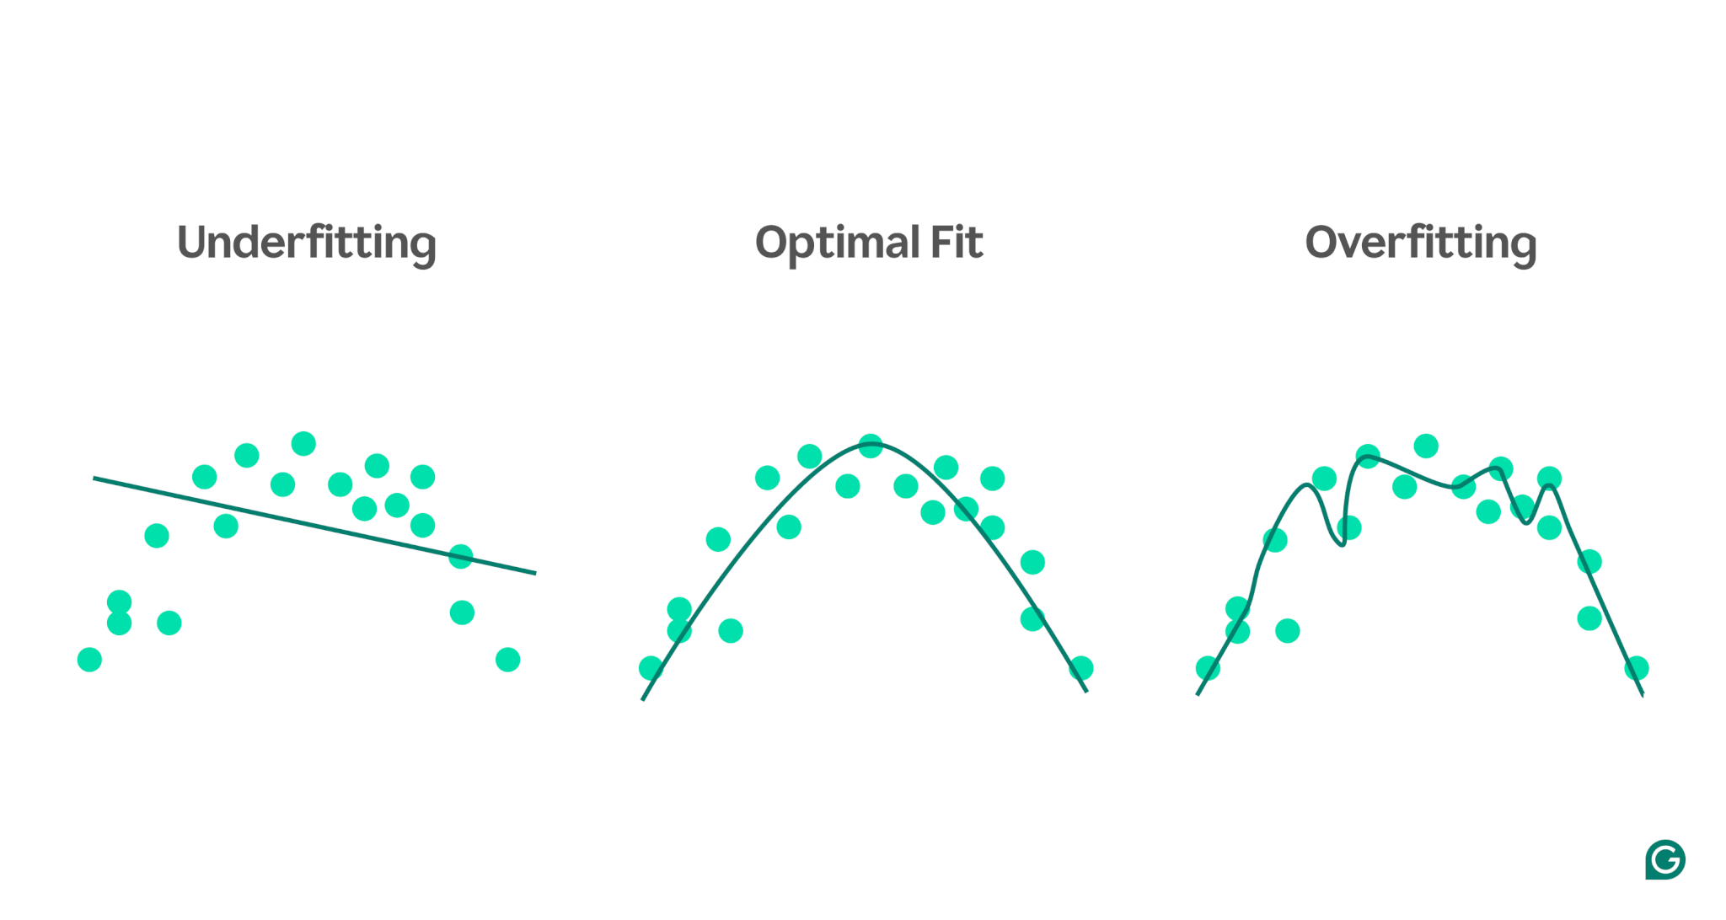
Overfitting & How We Judge Success
Train → Validation → Test
Separate data splits reveal true generalization.
Spot Overfitting
Training loss decreases while validation loss increases—model memorizes noise.
Regularization Tools
Dropout
Weight decay (L2 penalty)
Early stopping
Key Metrics
Accuracy and F1 for classification
BLEU and ROUGE for language tasks
Mean Squared Error (MSE) for regression
Stop Rule
Save model weights at lowest validation loss—not at the last training epoch.
Notes:
Now, before we ship any model, we have to be sure it learned real patterns, not just memorized the training data.
First, we use three data splits:
The training set is what the model learns from.
The validation set helps us tune hyper-parameters—these are settings like learning rate or network size that control training behavior but aren’t learned themselves.
The test set is held back and only used once at the end to get a final, honest performance score.
A common problem is overfitting: when the training loss keeps improving, but the validation loss starts getting worse.
This means the model is memorizing quirks or noise in the training data instead of learning generalizable patterns.
The opposite problem is underfitting: when both training and validation losses stay high because the model is too simple or hasn’t trained long enough.
To fight overfitting, we use regularization techniques:
Dropout randomly silences neurons during training, so the network can’t rely on any single path.
Weight decay, also called L2 penalty, discourages weights from growing too large.
Early stopping means we save the model checkpoint at the point where validation loss is lowest, and stop training before the model starts memorizing.
Success is measured by task-specific metrics:
Accuracy and F1 score for classification tasks.
BLEU and ROUGE scores for translation and summarization, which measure how well generated text matches human references.
Mean squared error for regression tasks, which measures prediction error in continuous values.
Whatever the metric, we only report the number from the unseen test set—that’s our best estimate of how the model will perform in the real world.
So, the best model isn’t the one with the lowest training loss; it’s the one that balances fit and generalization, proven by strong validation and test scores.

Slide 28
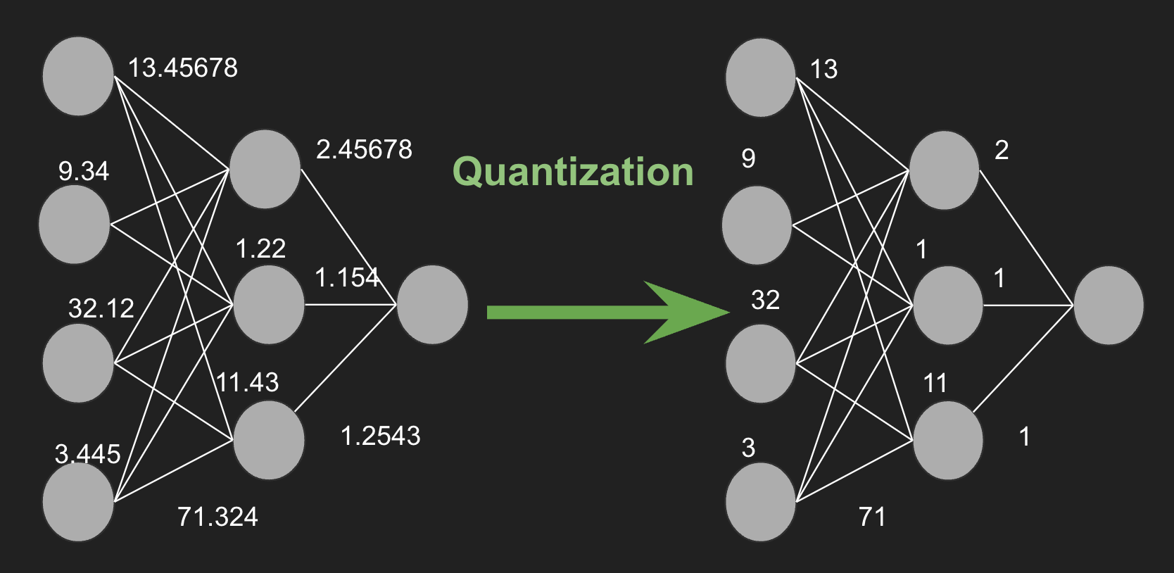
Quantization & Why These Concepts Matter
Quantization • Converts 32-bit weights/activations to lower precision (8-bit, 4-bit) • Shrinks model size & speeds up inference on edge devices • Common model sizes: 2B, 4B, 8B, 16B parameters; quant reduces footprint dramatically
Why These Matter • Data choice shapes what a model can learn (and what it misses) • Fine-tuning transforms general models into domain experts • Self-supervision scales learning without costly labeling • Quantization makes deployment practical—AI everywhere, from phones to servers
Notes:
Let’s talk deployment—and why these training principles really matter.
Quantization is an efficiency trick that converts high-precision 32-bit weights and activations into lower-precision formats—like 8-bit, 4-bit, or even mixed precision.
This shrinks model size, cuts memory bandwidth, and speeds up inference, making it possible to run large models on edge devices, phones, or modest GPUs—with only a small accuracy trade-off.
Common quantized model sizes range from 2 billion to 16 billion parameters, balancing efficiency and performance.
Why do you need to understand these concepts?
Because data choice dictates what your model can learn—and what it misses.
Fine-tuning lets you adapt a general-purpose model into a specialized expert, saving time and data.
Self-supervision unlocked scaling to trillion-token corpora, fueling the impressive in-context learning and emergent behaviors of today’s LLMs.
And quantization ensures you can deploy those heavy hitters in the real world, from cloud servers to mobile and edge devices.
Together, dataset curation, fine-tuning, self-supervised pre-training, and model quantization comprise the full lifecycle of modern AI: build, adapt, and deploy.

Slide 29
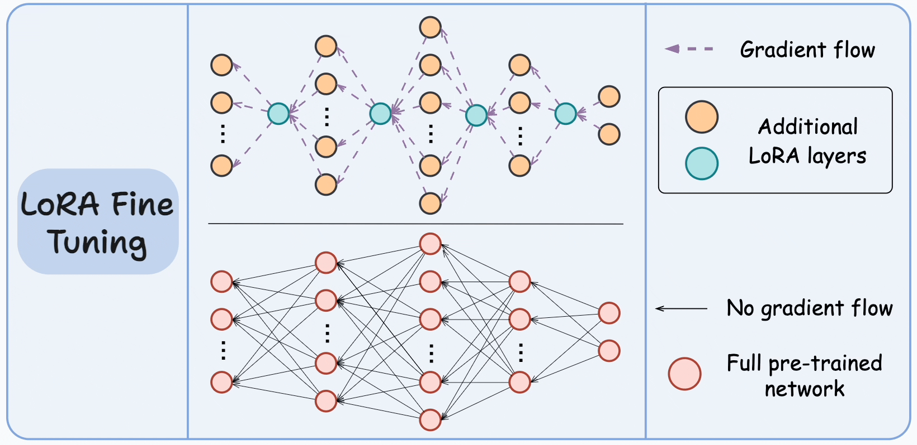
Efficient Fine-Tuning Techniques
Low-Rank Adaptation (LoRA) • Injects trainable, low-dimensional matrices instead of updating all weights • Cuts GPU memory usage & training time dramatically
Prompt Tuning & Prefix Tuning • Learn soft prompts or prefixes rather than full model weights • Lightweight, keeps base model frozen
Why It Matters • Enables domain specialization on commodity hardware • Reduces costs & carbon footprint of fine-tuning giant LLMs
Notes:
Speaking of adaption…
Because full fine-tuning of a multi-hundred-billion-parameter model can be prohibitively expensive, researchers developed parameter-efficient methods.
One leading approach is LoRA, or low-rank adaptation. Instead of updating every weight, LoRA inserts small, trainable low-rank matrices into each layer.
That slashes GPU memory needs and cuts training time, while still delivering performance on par with full fine-tuning.
Other tricks like prompt tuning or prefix tuning freeze the main model and only learn a small set of soft prompt vectors—think of these as virtual “questions” that steer the model’s behavior.
These lightweight techniques let you achieve specialized performance without owning a deep-learning cluster.
Mastering these methods is essential for making LLM customization accessible—from cloud VMs to even high-end workstations.

Slide 30
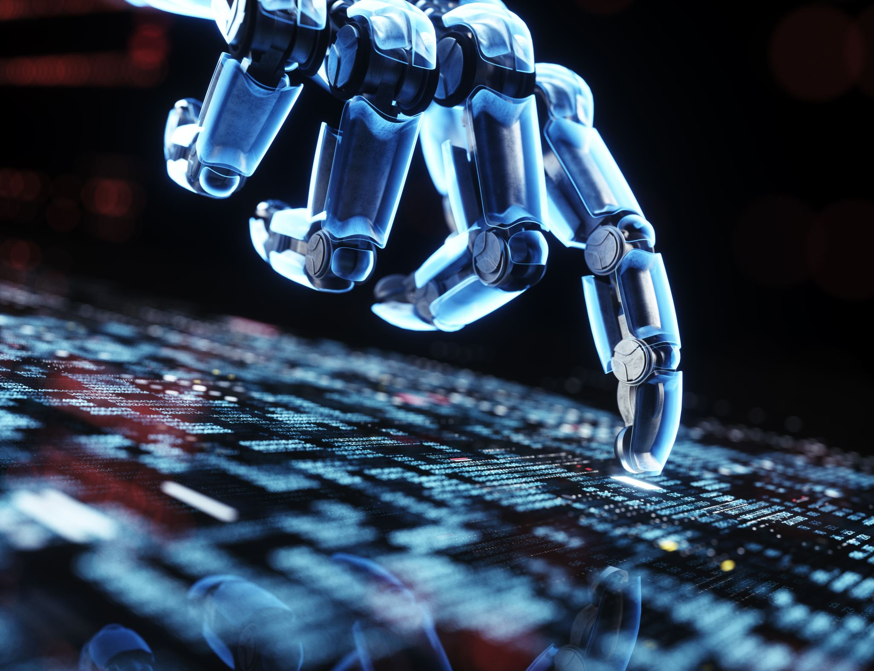
Takeaways & Next Steps
AI ≠ Sci-Fi; It’s Math + Code Narrow AI solves specific tasks—no Skynet here! …yet!
3 Ways Machines Learn Supervised, Unsupervised, Reinforcement.
Neural Nets 101 Layers + weights + activations → backpropagation tweaks the knobs.
Scale = Power Data × Compute × Deep Nets → GPT-4, PaLM, Claude.
Data Rules Clean data + fine-tuning beats clever hacks; self-supervision unlocks trillions of tokens.
Deploy Smart Quantization, LoRA & other efficiency tricks bring LLMs to laptops & edge devices.
Up Next: Generative AI, Python tool-chain, RAG, hardware, ethics & frontier models.
Notes:
Let’s wrap Act 1 with seven bite-size takeaways:
First—AI is just math and code. We busted some Hollywood myths and saw that today’s systems are narrow specialists, not sentient robots—yet.
Second—the three learning styles. Supervised is flashcards with answers, unsupervised is pattern-hunting with no labels, and reinforcement is trial-and-error with rewards.
Third—neural-network plumbing. Layers, weights, and non-linear activations flow forward; backpropagation plus gradient descent nudge every weight until the error shrinks.
Fourth—scale changes the game. When you multiply data, compute, and deep architectures, you unlock Large Language Models like GPT-4 and PaLM.
Fifth—data quality rules. Garbage in, garbage out still applies; fine-tuning clean, domain-specific data turns a general model into an expert, while self-supervision lets us learn from oceans of unlabeled text and images.
Sixth—deploy smart. Tricks like quantization and low-rank adaptation shrink models from 32-bit giants to 8-bit—or even 4-bit—so they run on laptops, phones, and edge devices without much accuracy loss.
Seventh, and most exciting: what’s next! In Act 2, we’ll dive into generative AI techniques, essential Python libraries, retrieval-augmented generation with vector databases, hardware choices, ethics and regulation, the latest frontier models, and hands-on project ideas.
Thanks for sticking with me through this firehose of information on the foundations of AI—I hope you’ve learned something valuable, and I can’t wait to see you in Act 2!

